Slide 1
Lecture - 20
Chapter 11
FEATURE EXTRACTION

Slide 2
Representation and Description
Representation and Description
Representing regions in 2 ways:
Based on their external characteristics (its boundary):
Shape characteristics
Based on their internal characteristics (its region):
Regional properties: color, texture, …
Both
CPE415 Digital Image Processing | Dr. Ikramullah Khosa

Slide 3
Representation and Description
Representation and Description
Describes the region based on a selected representation:
Representation >> boundary or textural features
Description >> length, orientation, the number of concavities in the boundary, statistical measures of region.
Invariant Description:
Size (Scaling)
Translation
– Rotation
CPE415 Digital Image Processing | Dr. Ikramullah Khosa

Slide 4
Representation and Description
Boundary-based Descriptors
Freeman chain code
Signature
Shape number
Fourier descriptor
Region-based Descriptors
Some basic descriptors
Topological descriptors
Texture
Statistical approaches
Gray level Co-occurrence Matrix (GLCM)

Slide 5
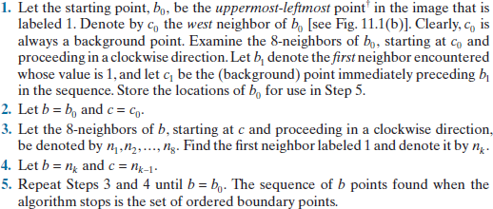
Moore Boundary Tracing Algorithm

Slide 6
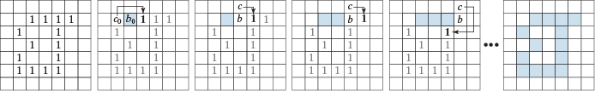

Moore Boundary Tracing Algorithm

Slide 7
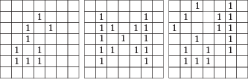

Moore Boundary Tracing Algorithm

Slide 8
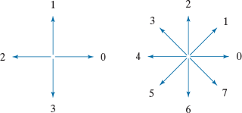

Freeman Chain Code

Slide 9
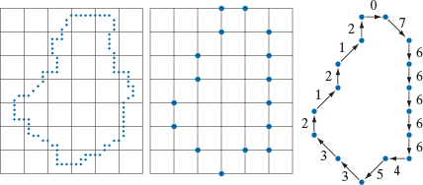

Freeman Chain Code

Slide 10
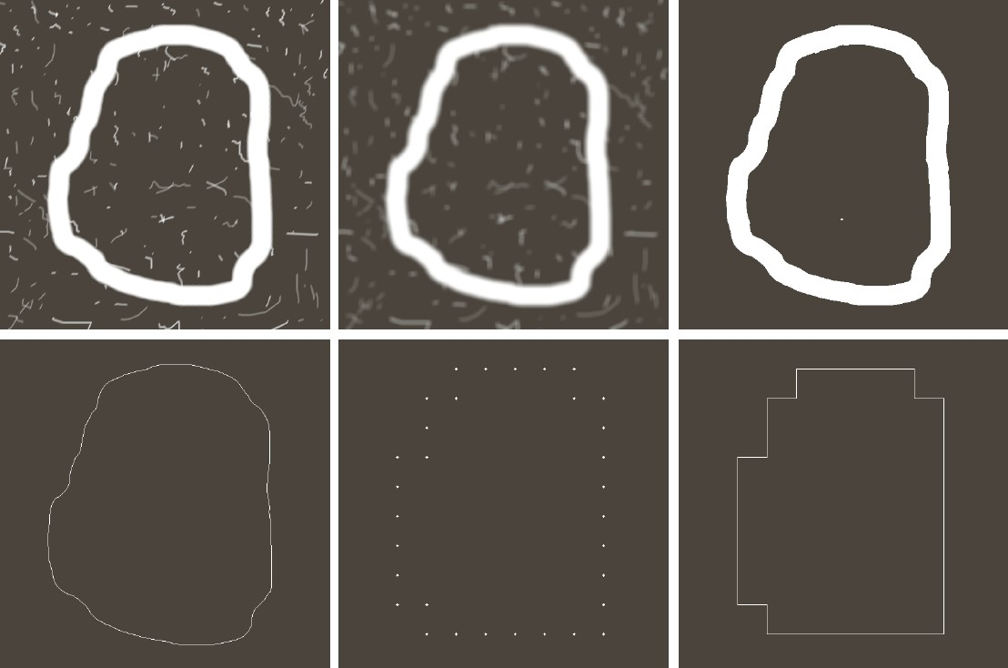

Freeman Chain Code

Slide 11
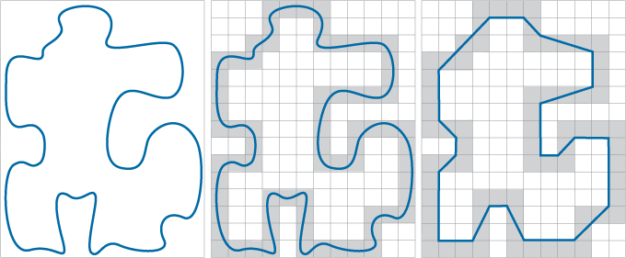

Boundary Approximation using Minimum Perimeter Polygon (MPP)

Slide 12
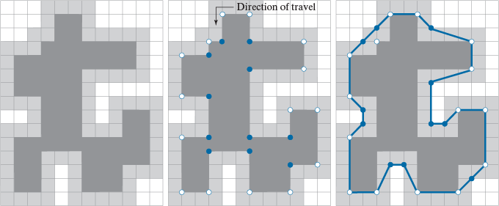
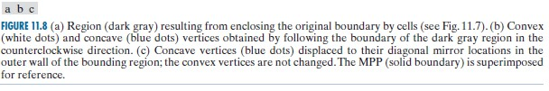
Boundary Approximation using Minimum Perimeter Polygon (MPP)

Slide 13


Boundary Approximation using Minimum Perimeter Polygon (MPP)

Slide 14
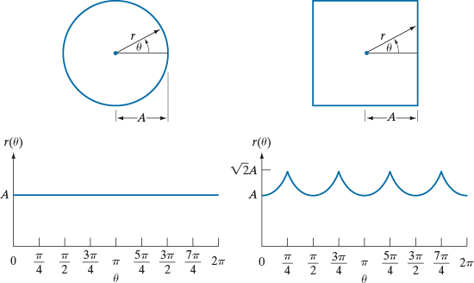

Signatures

Slide 15
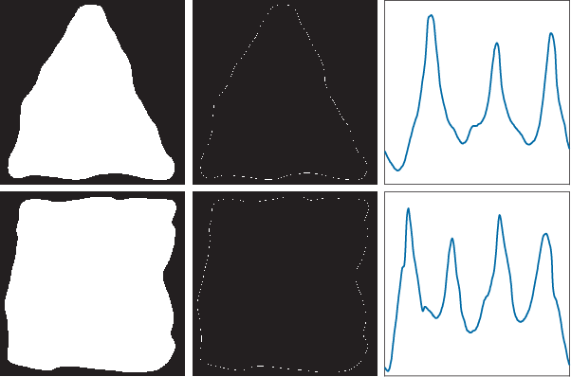
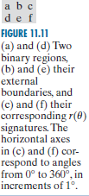
Signatures

Slide 16
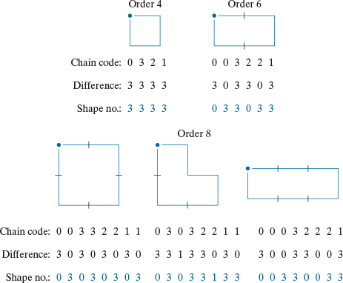

Shape Number (Boundary Feature Descriptors)

Slide 17
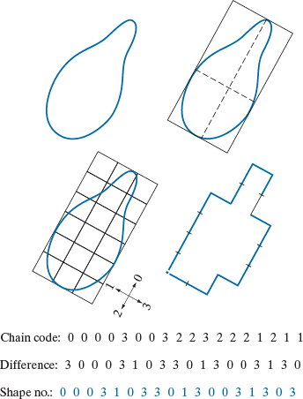

Shape Number (Boundary Feature Descriptors)

Slide 18
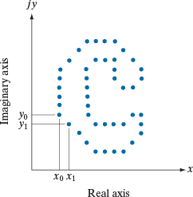




Fourier Descriptor
(DFT)
(IDFT)
(IDFT using P
fourier Coefficients)

Slide 19
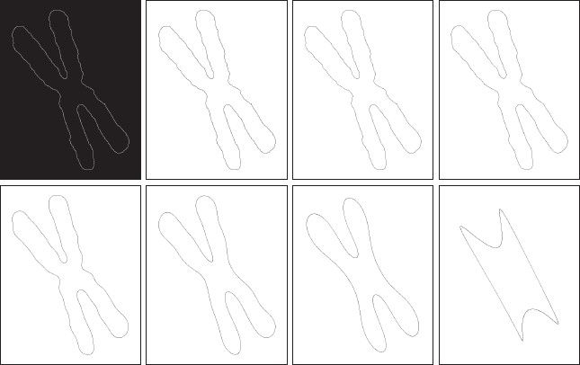
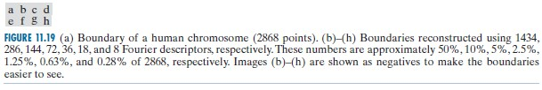
Fourier Descriptor

Slide 20
Fourier Descriptor
(DFT)
(IDFT)
(IDFT using P
fourier Coefficients)

